Slide 1
Portfolio
(Html&Css)
James Ma
2.4.2020

Slide 2
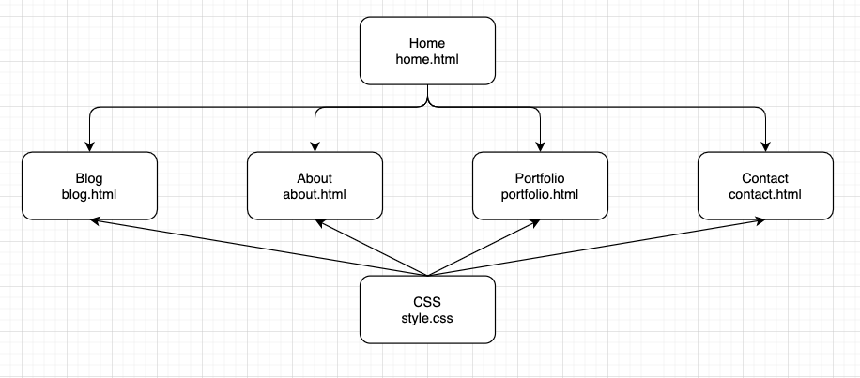
Sitemap

Slide 3

My Website

Slide 4
Design Process

Slide 5
Consistent style Find suitable fonts
Find the right way to realize effects
Think what i want
Function Design
Browse Dribble
Page design
Wireframe
Implementation
Looking for some inspiration
Basic structure Contents

Slide 6
Component List
Nav bar - Left
Footer - Bottom
Contact button for link
Link button for CV
Cards for portfolio items
Contact form
Submit button for contact form
List for blog items
...

Slide 7

Home

Slide 8
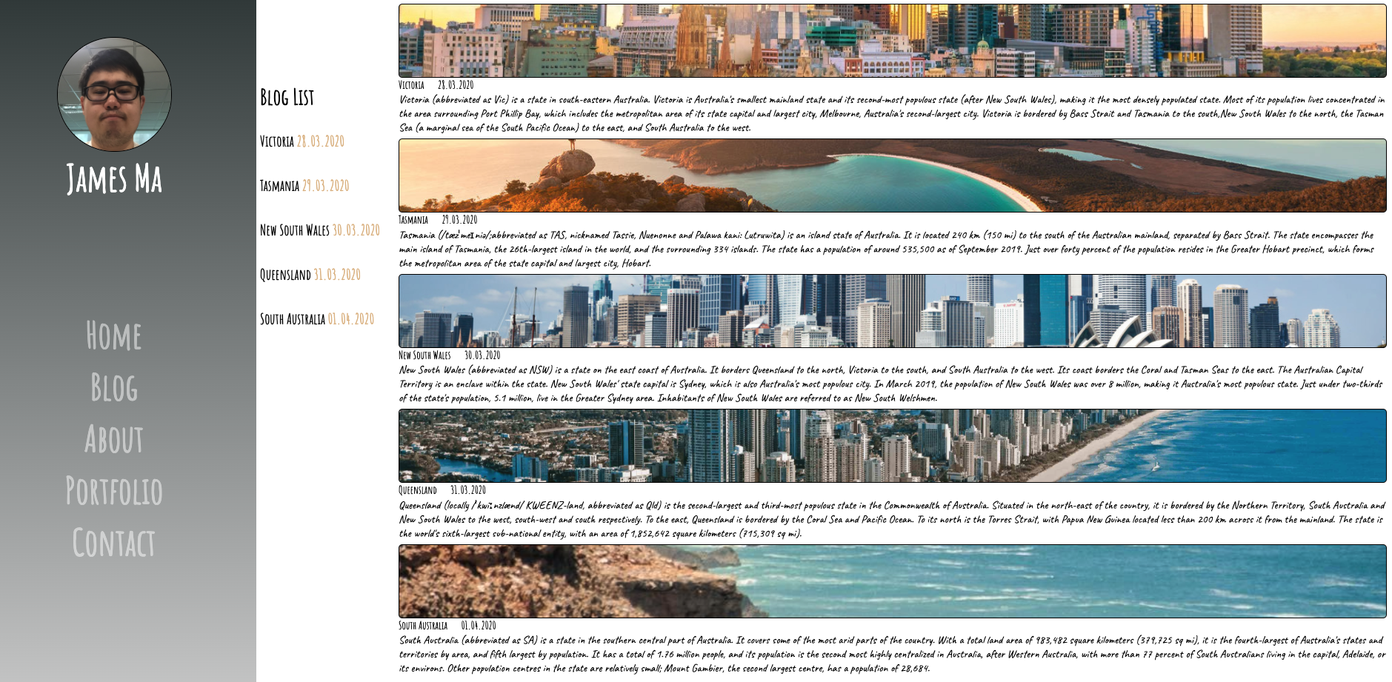
Blog

Slide 9
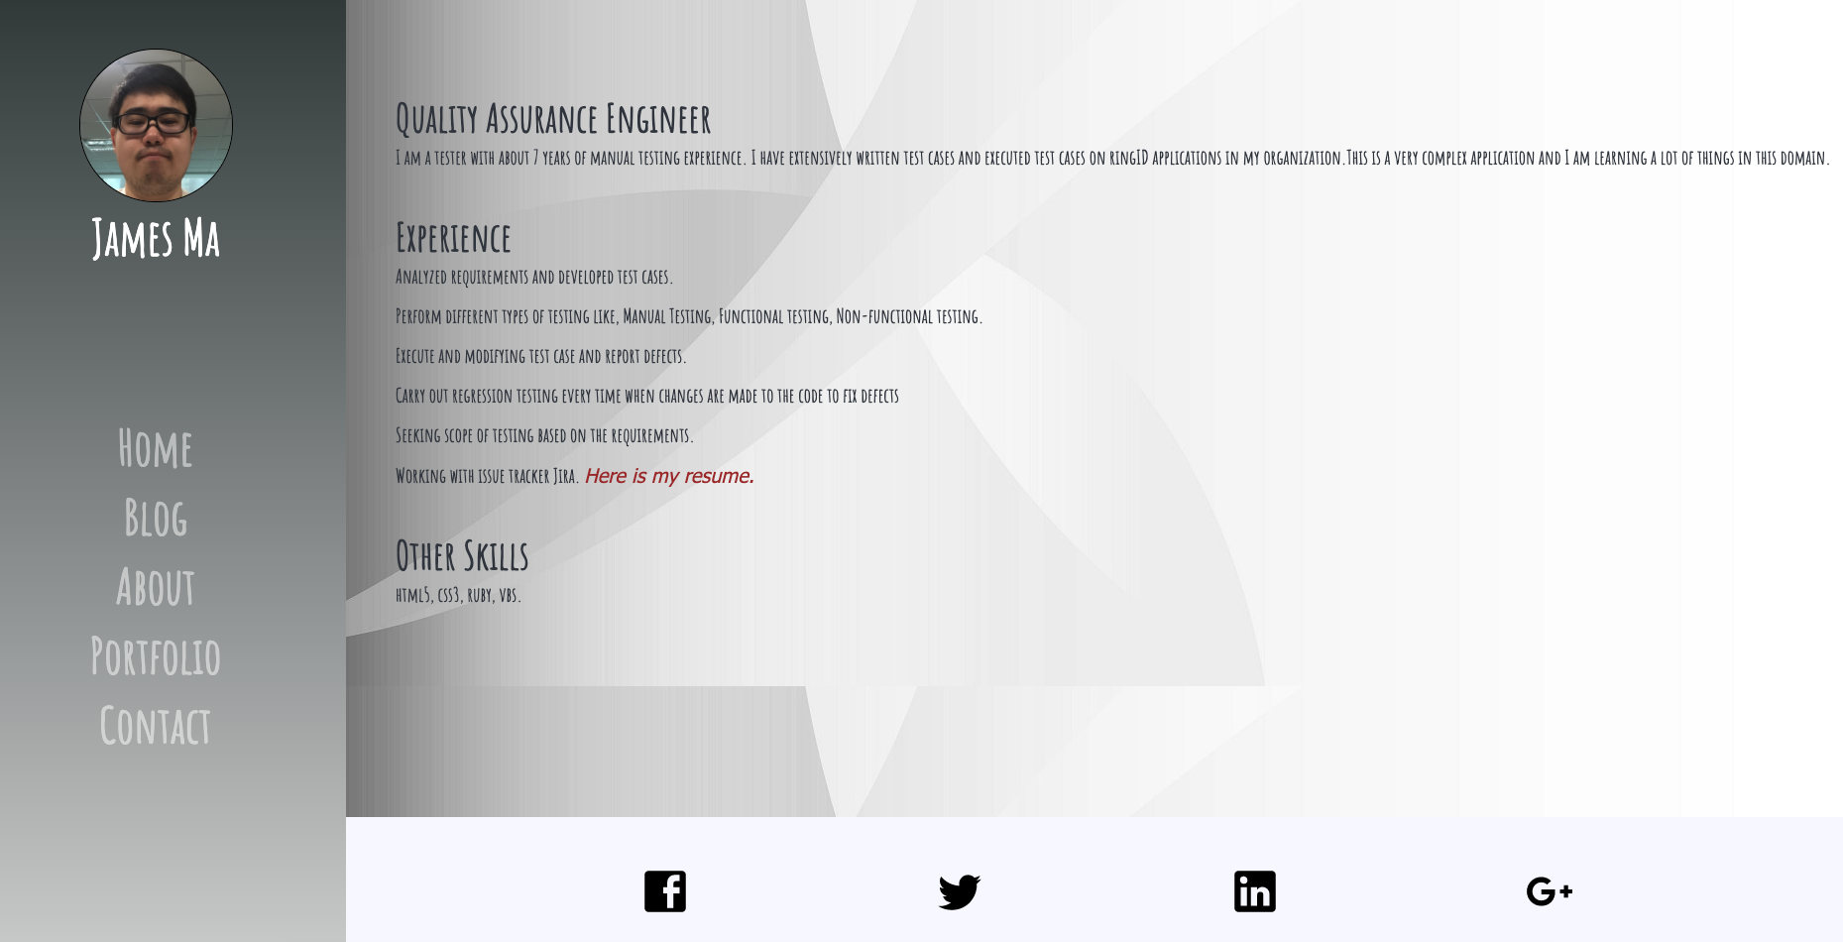
About

Slide 10
Portfolio

Slide 11
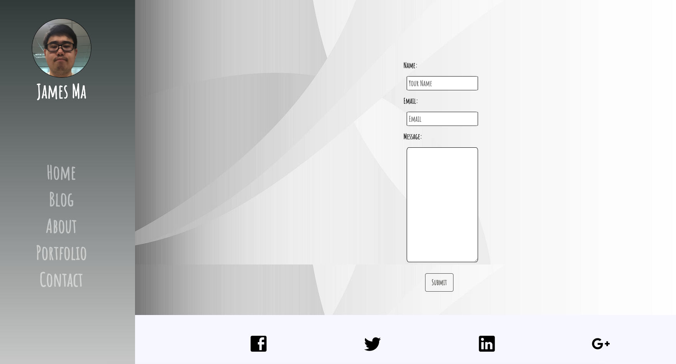
Contact

Slide 12
Flexbox
Responsiveness
Tag
Image size
...
Challenges

Slide 13
Favourite Parts
CSS Animation
Clock
Slide

Slide 14
THE END

